Slide 1

Weekly Progress
Team C

Slide 2
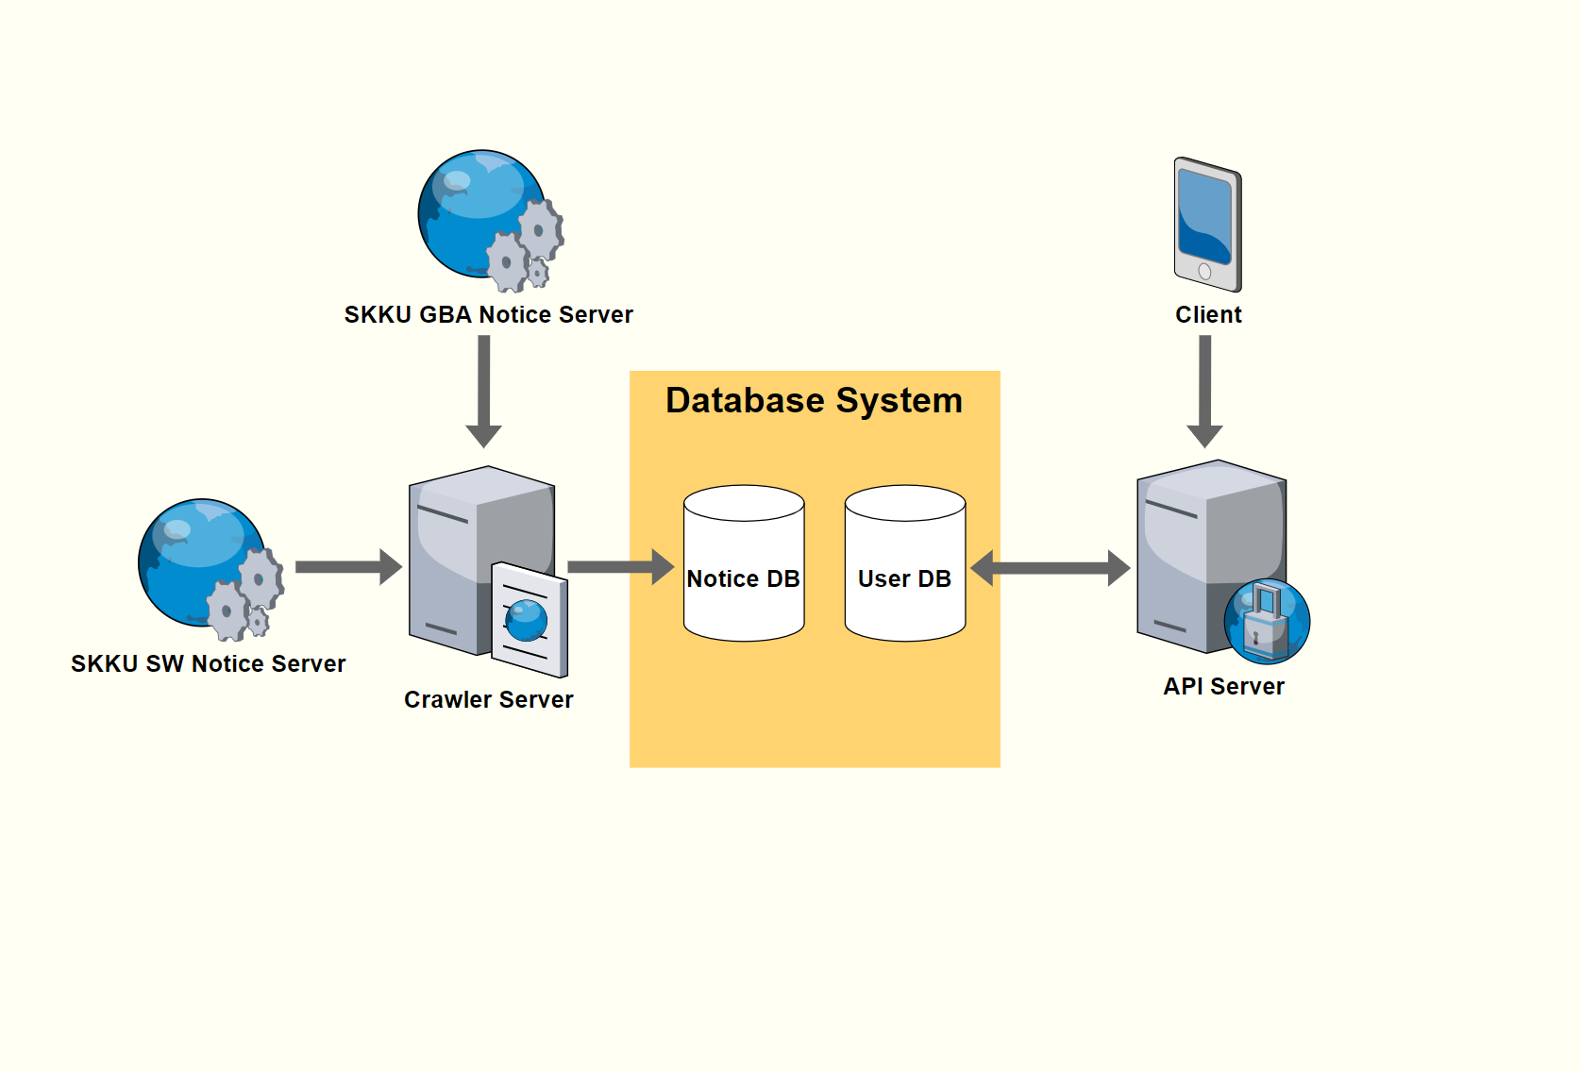
Application System Diagram
Figure 1 Application System

Slide 3
Progress Update on Front-End Development
Overall Structure of Flow Determined
On the following slides
2. Actual User API in Consideration
Currently in progress

Slide 4
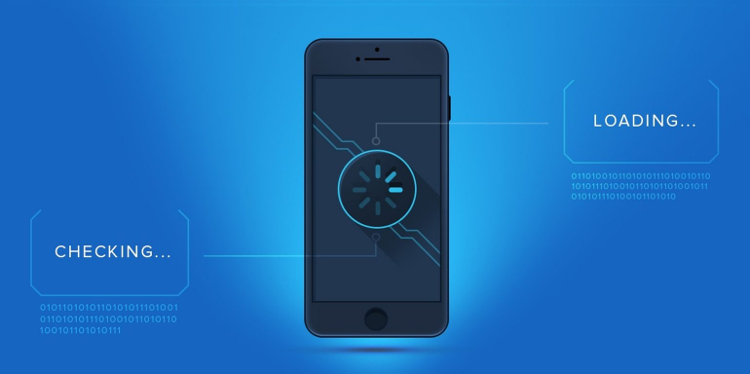
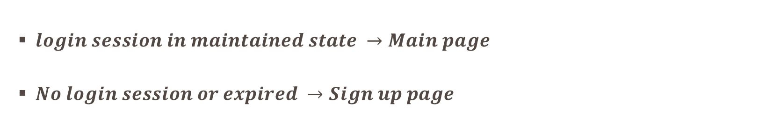
Splash Page: Automatic Sign In by Using Local DB
Figure 2 Splash Page [1]
$login session in maintained state →Main page$
$No login session or expired →Sign up page$

Slide 5
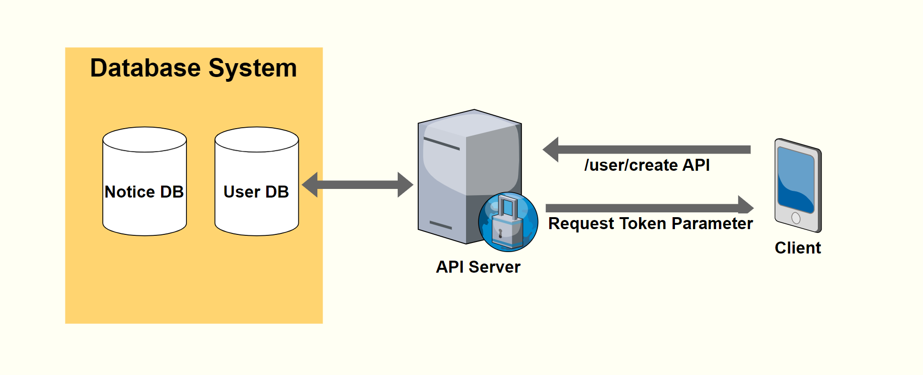
Sign Up Page
Figure 3 Interaction between client and server

Slide 6
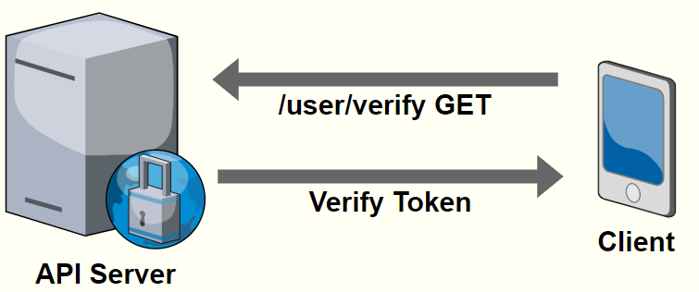
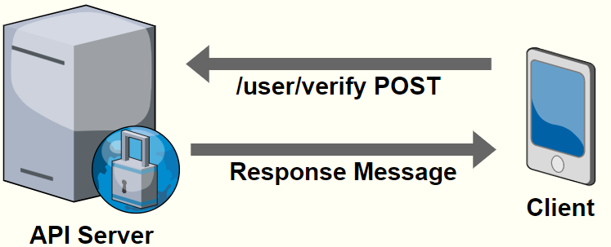
Authentication Page
Step 1 GET Request at /user/verify
Request
Verification Code
Step 2 POST Request at /user/verify
Send
Authentication Request

Slide 7
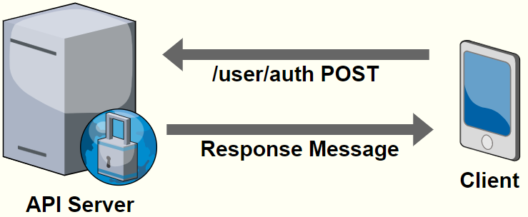
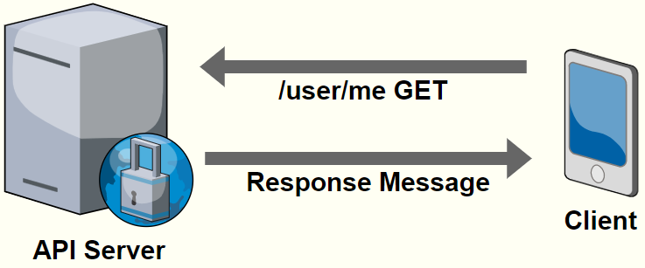
Log-In Page
Step 1 POST Request at /user/auth
Login Request
Step 2 GET Request at /user/me
Verify Existing User info

Slide 8
Completed Tasks in Back-End Development
User Authentication Process
Crawler Server Setting
Database Setting Completion

Slide 9
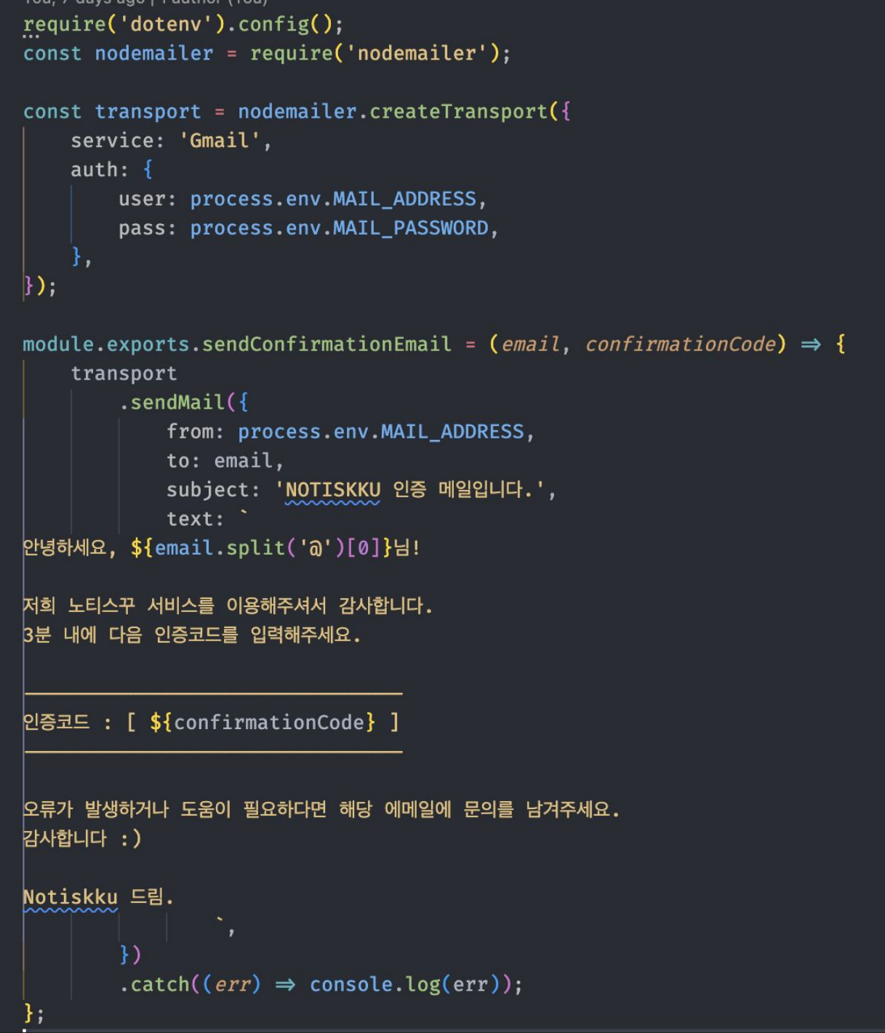
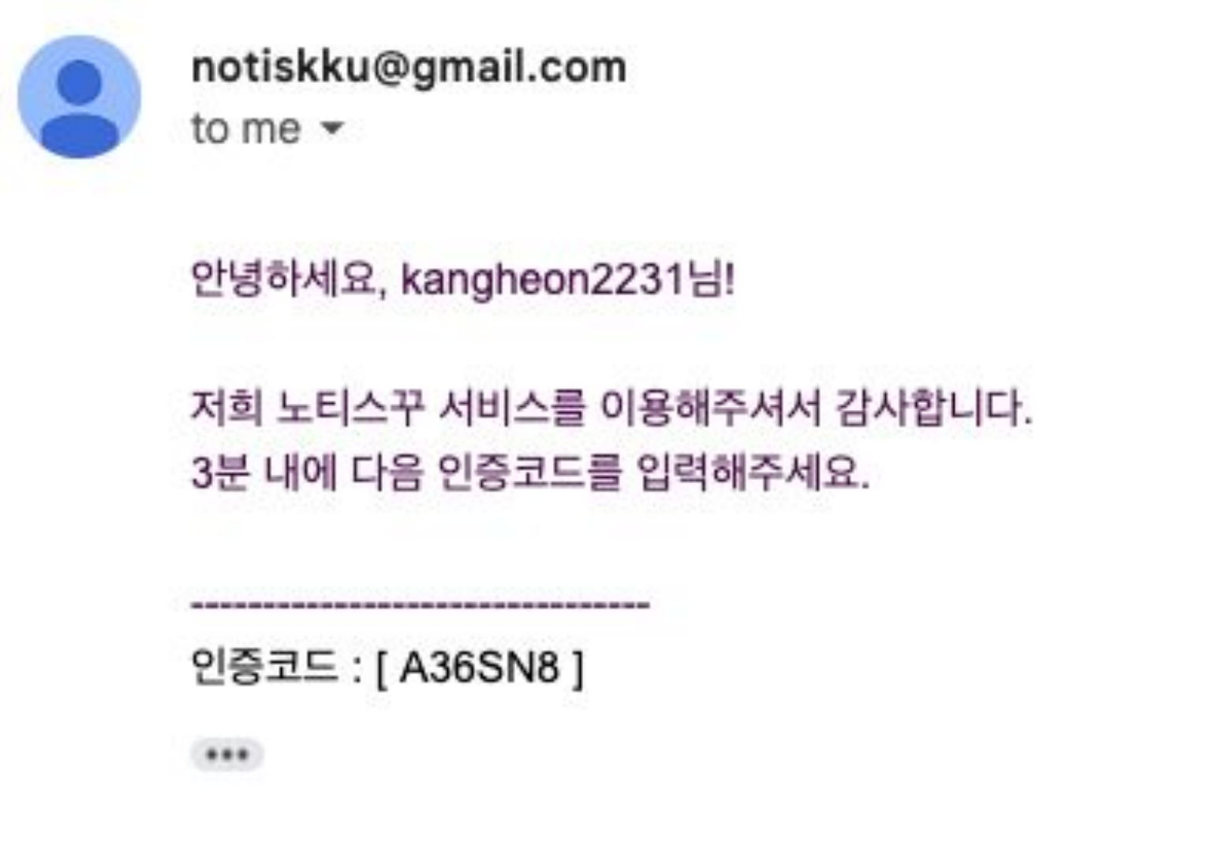
Completed Tasks in Back-End Development
Figure 4 Crawling Process [2]

Slide 10
Completed Tasks in Back-End Development
User Authentication Process
Crawler Server Setting
Database Setting Completion

Slide 11
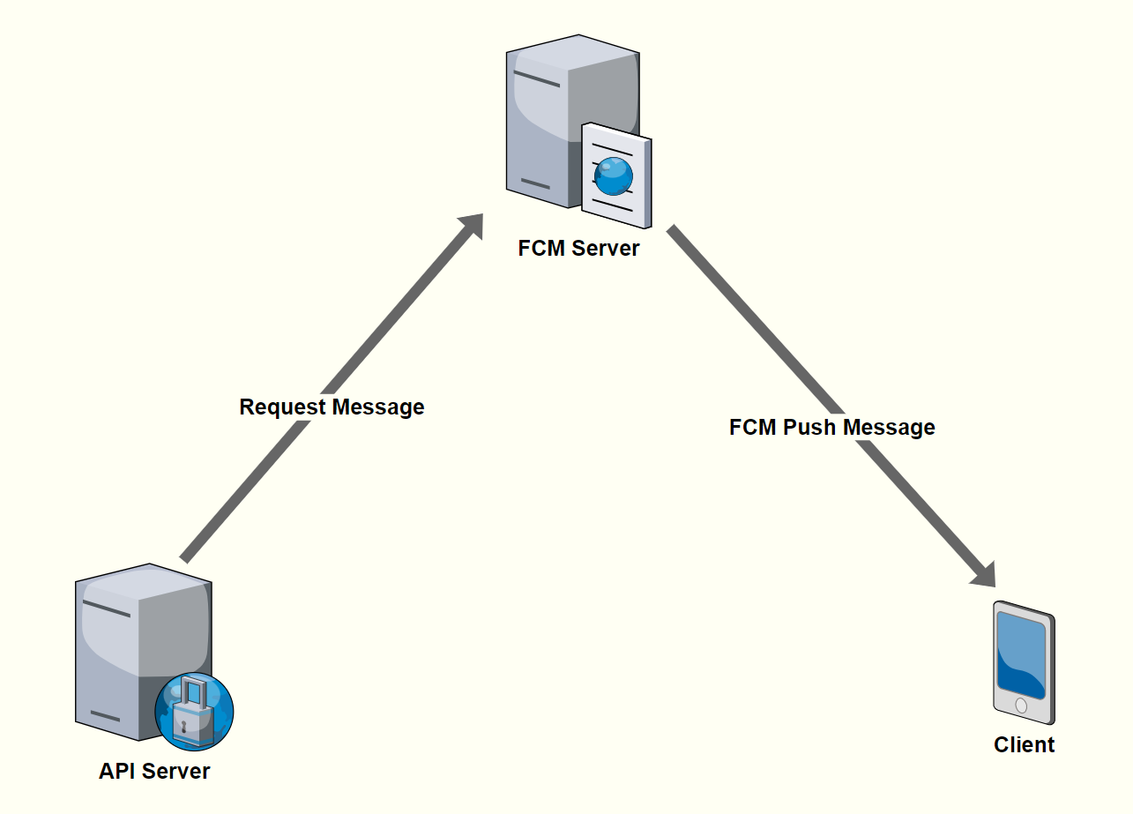
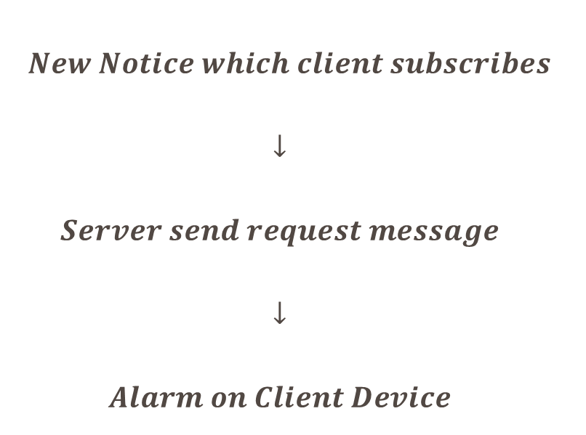
FCM: Firebase Cloud Message
Message Path
$$New Notice which client subscribes$$
$$↓$$
$$Server send request message$$
$$↓$$
$$Alarm on Client Device$$

Slide 12
Reference
[1] Ted Vrountas in Conversion Optimization, “The Magic of the Splash Screen”, https://instapage.com/blog/what-is-a-splash-screen/
[2] Dongheon Kang, “Weekly Update #2”, https://github.com/JYS1998/SWE3028-Team-C/blob/main/2.%20Presentation/Weekly%20Update%20%232.pdf

Slide 13
Progress Update on Back-End Development
Test Server Setting
AWS Setting

